Slide 1


Team 71: Virtual Computer Mouse using mmWave Radar (TI) Bi-Weekly Update 2
Oscar Chavez Araiza
Greyson Heath
Daniel Lu
Zane Meikle
Sponsor: Texas Instruments
TA: Vishwam Raval

Slide 2
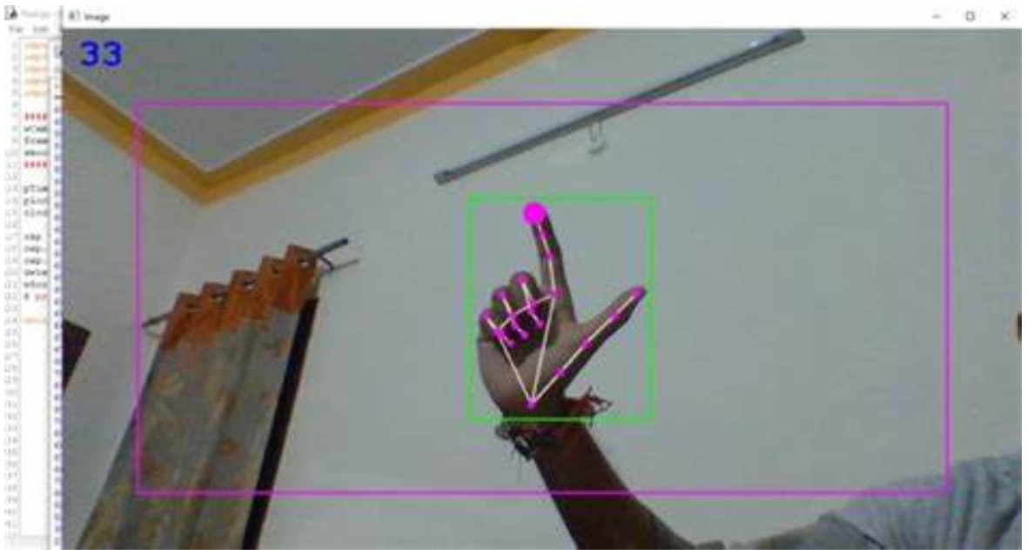
Project Summary:
Problem statement:
Virtual mice today are traditionally done using computer vision and a camera (as seen on the right).
But these systems are processing and power intensive.
High-level summary:
Create a virtual mouse using a Texas Instruments (TI) mmWave Radar and a ML model to make a less power and processing intensive virtual mouse.

Slide 3
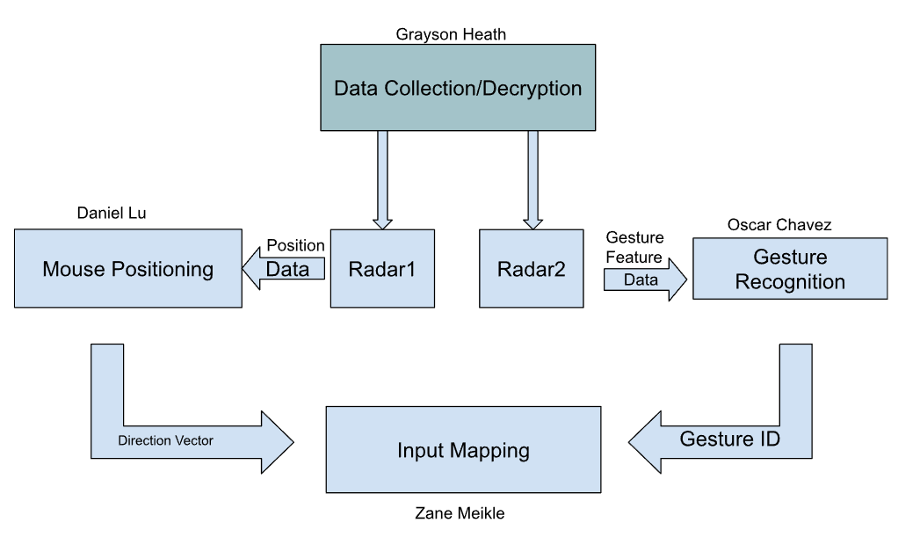
System Overview

Slide 4
Major Project Changes for 404
Currently, we are integrating what we have. Afterwards, we plan to do the following proposed changes:
Interactive GUI - Provides feedback and sensitivity adjustments (Greyson)
Improving AI for gestures - New gestures for holding clicks (Oscar)
Mouse frame smoothing - Connect point A to point B with arbitrary frames to smooth motion (Daniel)
Parallelization of scripts - Parallelize the different scripts so they aren't running in one program (Zane)
Radar enclosure case - Protects devices and looks presentable (Greyson)

Slide 5
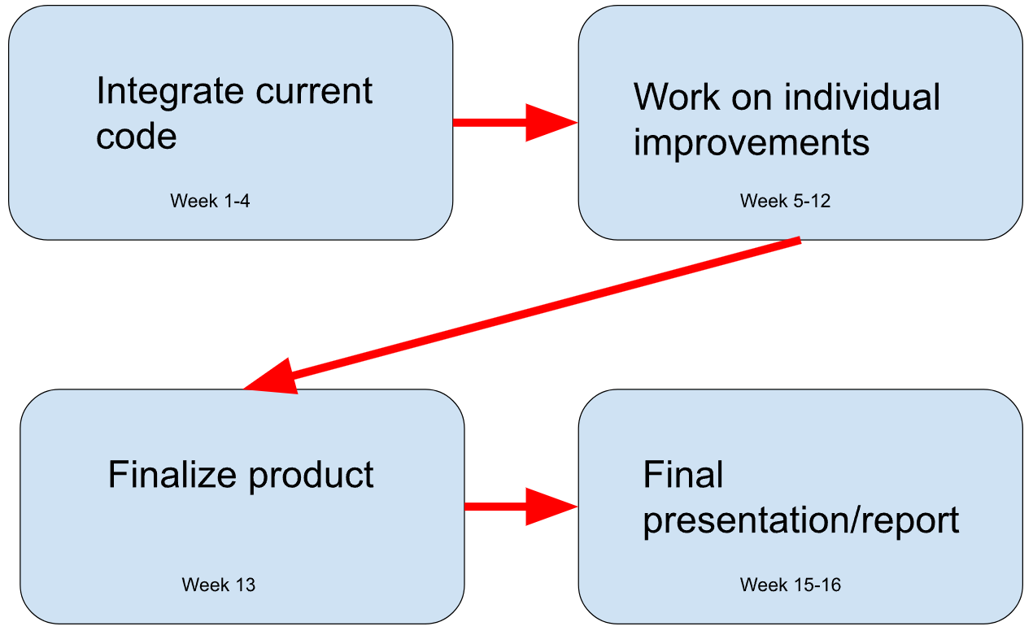
Project Timeline

Slide 6
Major Updates
The radar is able to move the mouse!
Gestures accurately decipher and send left/right clicks (Separately from moving mouse).
Removed the MMWAVEICBOOST.
Integrated all current code.

Slide 7
Major Issues
Mouse movements will not move the camera in Minecraft or Roblox.
Mouse movement is very Jittery.
Program is also fighting for resources causing gesture recognition to be slow.
Radars are interfering with each other
60-64 GHz Operating Band

Slide 8
Plans To Solve Major Issues
Change the function used to move the mouse.
To smooth the mouse movement we will try to average the points, starting with a moving average.
Parallelize the processes so they aren’t fighting for resources.
We are going to try to reduce it to one radar by changing the AI model or changing the data from the gesture recognition binary.

Slide 9
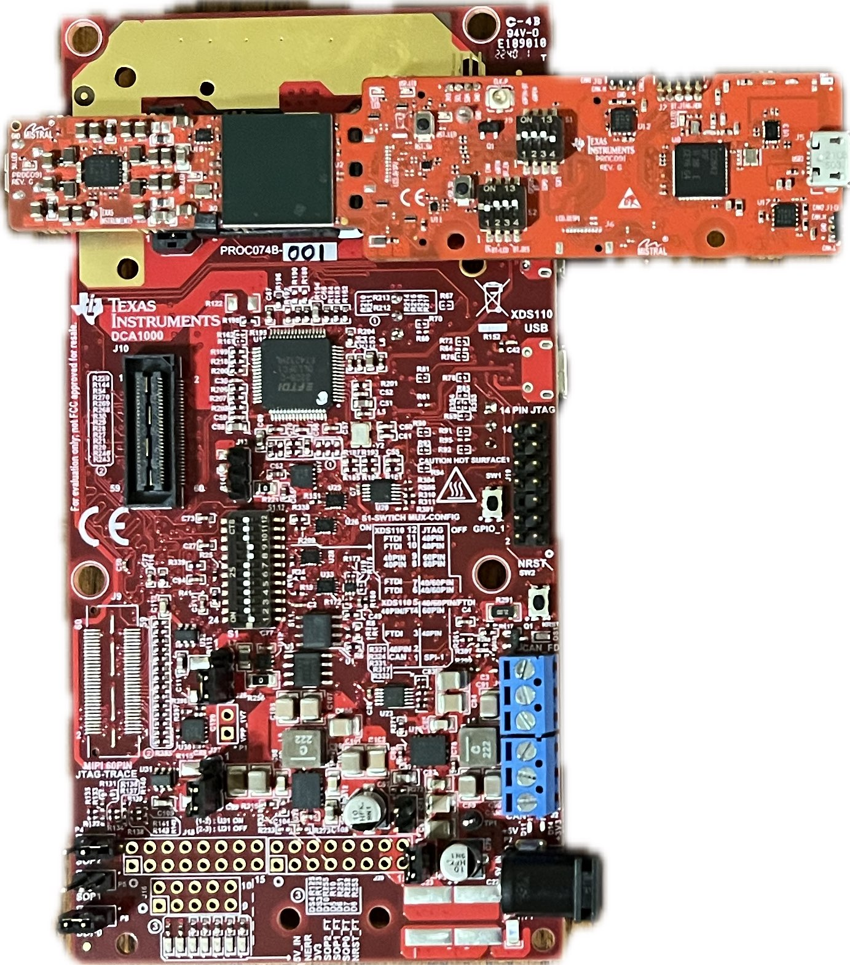

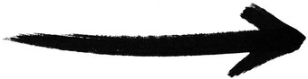
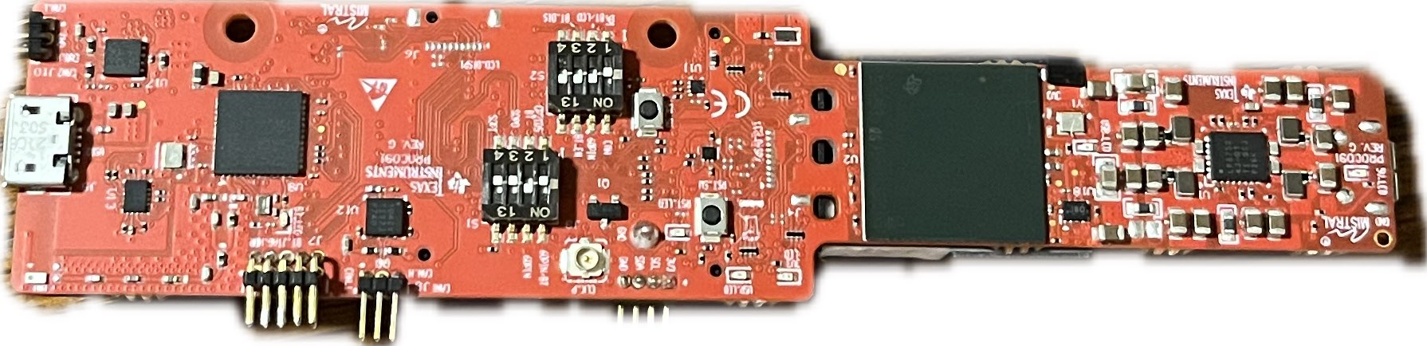
Chirp Config / Collect Data
Greyson Heath
Accomplishments since 403 <9> hrs | Ongoing progress/problems and plans until the next presentation
<6> ‘Working’ Prototype <1> Sponsor Meeting <2> Removed MMWAVEICBOOST | Develop / print new 3D case model Solidify and thread Python GUI

Slide 10
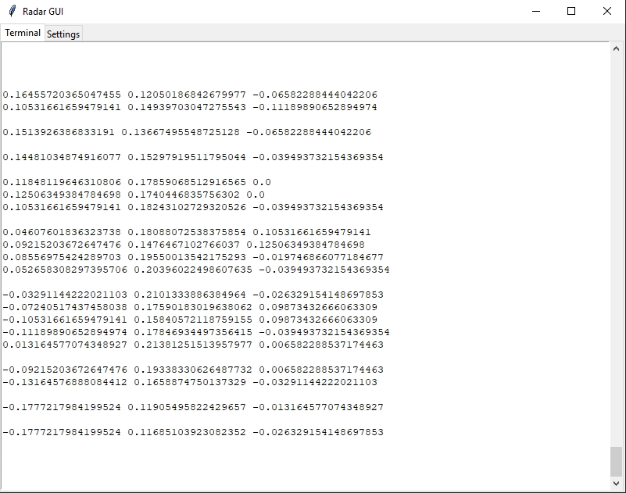
Radar GUI
Terminal
Live feed of ‘raw’ radar data (X, Y, Z)
New line = new frame
Settings (To be implemented)
On/Off
Sensitivity adjustments
Additional actions?...
TBD

Slide 11
-Gesture Recognition-
Oscar Chavez Araiza
Accomplished since 403 <~13> hrs | Ongoing progress/problems and plans until the next presentation
<1> Meeting with sponsor <2> Removed ICBOOST and tested the functionality of the system without the board <2> Fixing version problems <3> Training new gestures <5> Integration of the mouse movement with the gesture recognition. | Problems The software used for radar tracking was developed under python 3.7 3.12 did not support some packages used by TI’s radar software Both radars interact and sense each other. Radars need parallelization to extract radar values. Progress Version problems have been resolved If we place the radars sufficiently appart we can reduce the interaction.

Slide 12
Gesture Positioning
Daniel Lu
Accomplishments <10hr> | ECEN 404 ongoing progress/problems in the next 2 weeks
Combine the demo with Gesture Recognition demo<1hr> Generate real moving path of a gesture and test<2hr> Improve the accuracy of path by reducing the error caused by background objects<6hr> sponsor meeting<1hr> | geometric average coordinates average velocity make a smooth mouse movement path

Slide 13
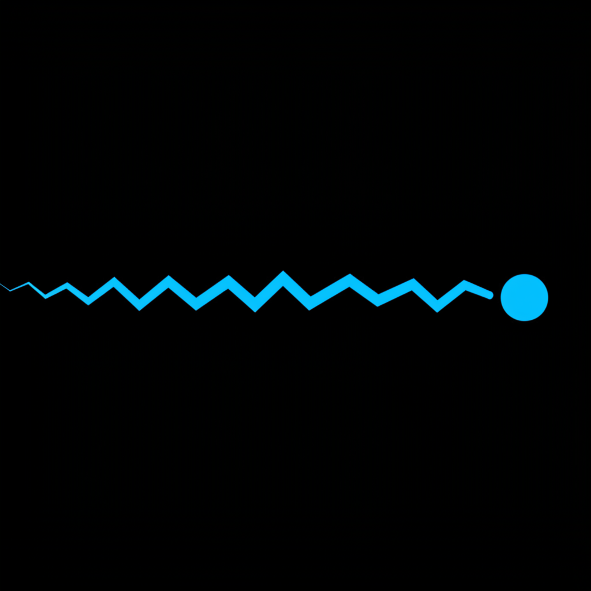
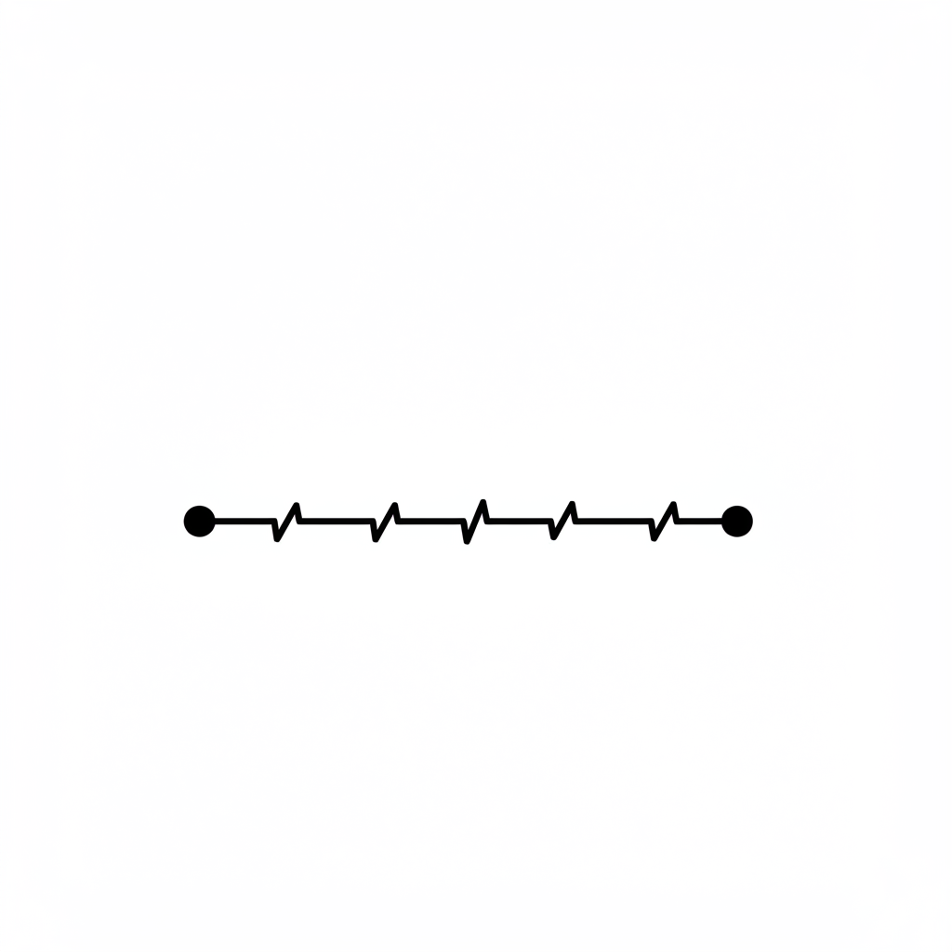

Slide 14

Improvement of positioning
ECEN 403 demo - generate velocity by calculate the vector between two average coordinates.
Improvement:
Use continuous average velocity to generate the path for mouse movement.
Use geometric average coordinates instead of average coordinates.

Slide 15
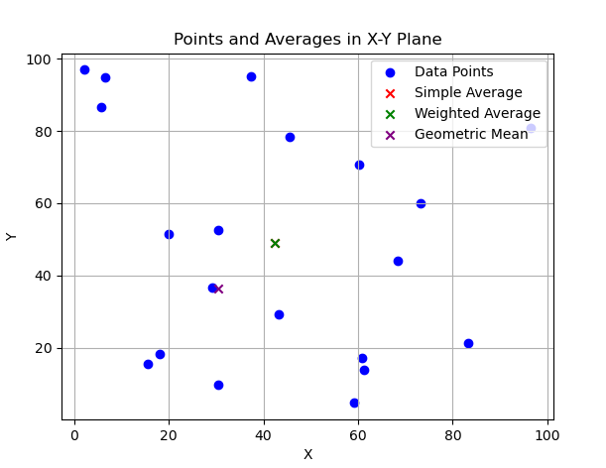
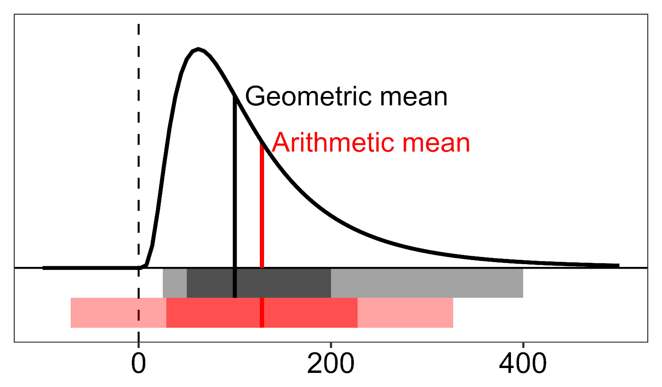

Slide 16
Input Mapping
Zane Meikle
Accomplishments since the last presentation <8> hours | Ongoing progress/problems and plans until the next presentation
<1> meeting with sponsor <3> Working on getting the radar to move the mouse <3> Working on integrating all the code <1> research into how to parallelize in Python | Problems: issues with final product, it is not working well as it is fighting for resources in one thread. Ongoing Progress: Working on seeing how we will move forward and how to parallelize the the program and get it to move properly to interact with games such as roblox and minecraft. Plans: Start improving the design to make it more functional

Slide 17
Parts Ordering Status
We do not need any new parts as such we haven’t ordered any.

Slide 18
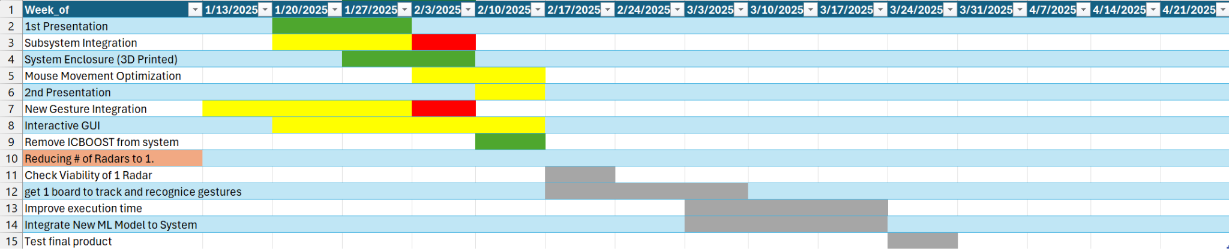
Execution Plan Gantt Chart

Slide 19
Validation Plan
Section | Task | Specification | Result | Owner
3.2.1.6 | Mouse Movement | Mouse can be moved to all corners of the screen by the program. | Passed | Zane
3.2.1.6 | Mouse Actions | The program must be able to right click and left click. | Passed | Zane
3.2.5.2 | Mouse Input Error Handling | The program must properly handle all invalid inputs. | Passed | Zane
3.2.1.4 3.2.1.6 | Gesture positioning | The coordinates of the gesture should be calculated when deleting the error points. | Passed | Daniel
3.2.1.6 3.2.1.8 3.2.3.2.1 | Velocity accuracy | The output velocity of the moving gesture should not have errors. | Passed | Daniel
3.2.1.5 | Hand Gesture Recognition | ML model can recognize the users hand gestures | Passed | Oscar

Slide 20
Validation Plan
Section | Task | Specification | Result | Owner
3.2.1.5 | Gesture Recognition Accuracy | ML model can correctly identify and categorize hand gestures at least 90% of the time. | Passed | Oscar
3.2.1.7 | Functional Radar System | The IWR6843AOPEVMs, and MMWAVEICBOOSTs all properly communicate with the computer and transmit data. | Passed | Greyson
3.2.1.8 | Data Decoding | The python script accurately decodes the TLV data seen from both radars. | Passed | Greyson
3.2.1.3 3.2.1.4 | Radar Angle and Distance | The radars can capture gestures and pointer positions within a 90 degree range up to 1.5 feet | Passed | Greyson
3.2.1.5 | Hand Size | Radar will recognize gestures regardless of hand size. | Passed | Oscar

Slide 21
That is all, thank you.

